Slide 1

Capstone Project Open Pit Mine
Nikita Patil
Vidya Tonage
Vivek Luniya
PGDDS – January 2022

Slide 2

Problem Statement
Open-pit mine is facing below problems
Inefficient production
Losing customers' trust as not able to meet their demands even there is now urgency

Slide 3

Data Availability for Analysis
Cycle Data: Includes all cycles and details during this cycle
Delay Data: includes all delay information caused by various reason and machines
Location Data: Includes Location details with Latitude and Longitude

Slide 4

Data Analysis Flow
Understand Given Data
Clean and Process Data
Create Master Tables to Used for Visualizations
Create Key Metrics Measures
Create Visualizations from Clean Data
Derive Insights from Visualizations to Find Solution to Problem

Slide 5
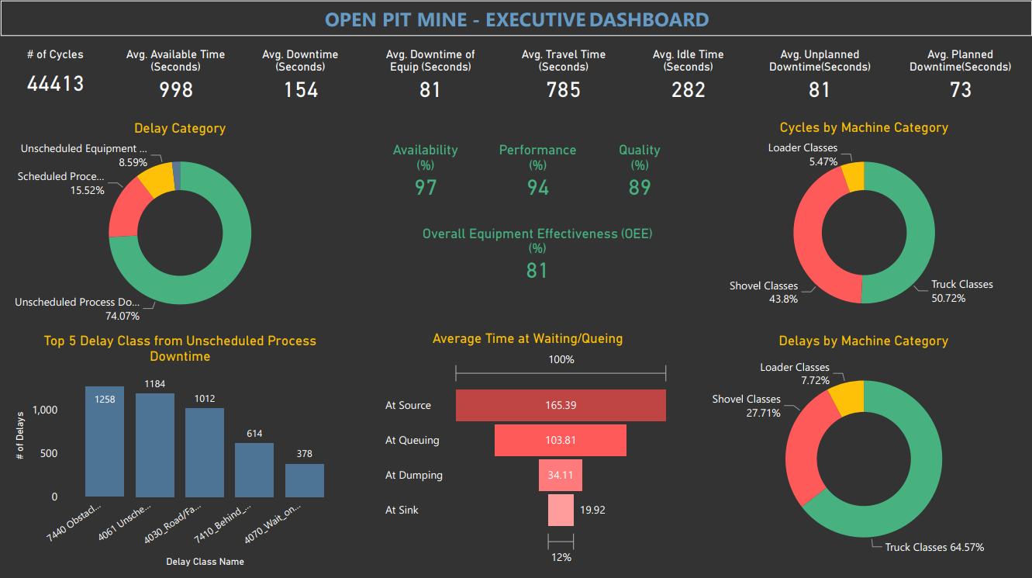

Slide 6
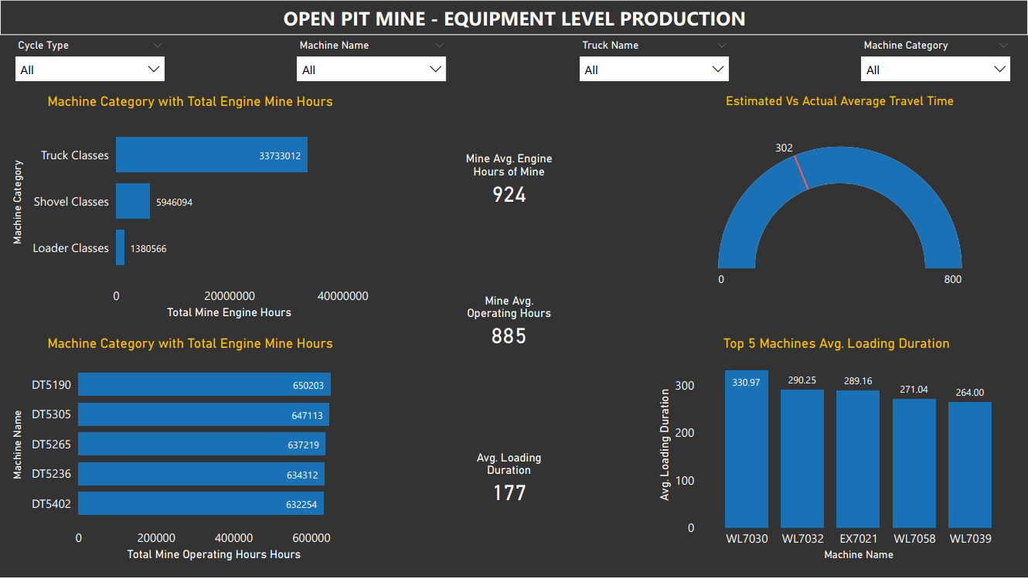

Slide 7
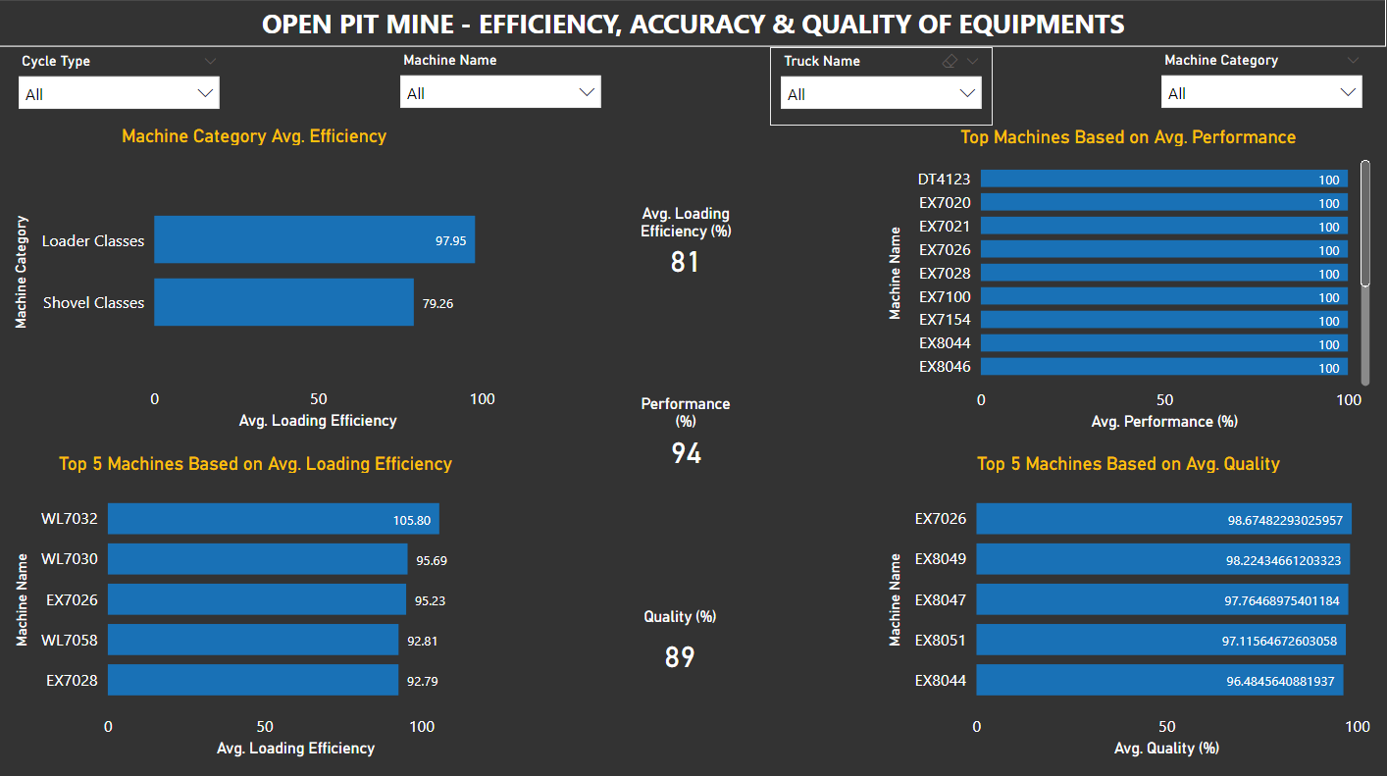

Slide 8
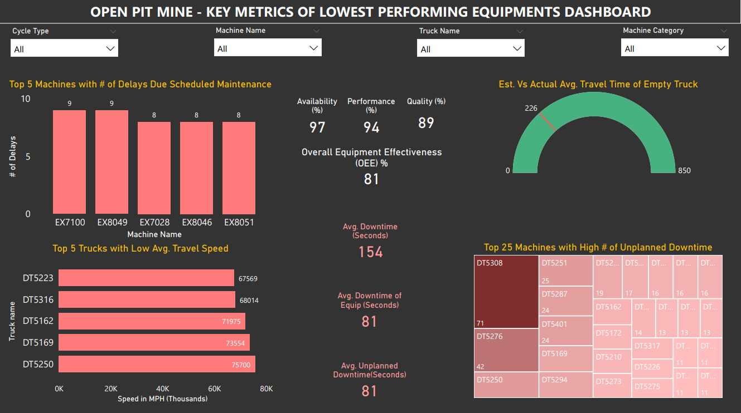

Slide 9
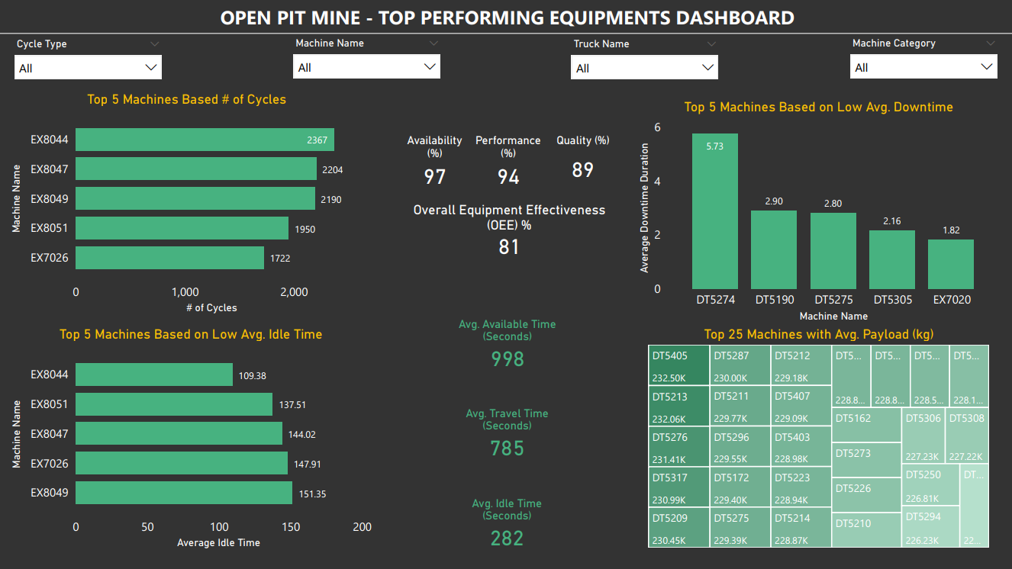

Slide 10

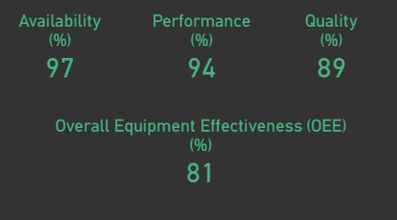
Data Insights to Resolve Problems
Key Metrics Derived From Data and Dashboard,
1. We understand the Quality is Primary area to improve.
2. There is significant UNPLANNED downtime observed which need to reduce by increasing frequent scheduled maintenance.
3. In Machine category, it is important increase trucks efficiency which most contributing process delay presently.

Slide 11



Data Processing & Visualization Tools Used
MySQL Workbench 8.0
Microsoft Power BI

